Slide 1
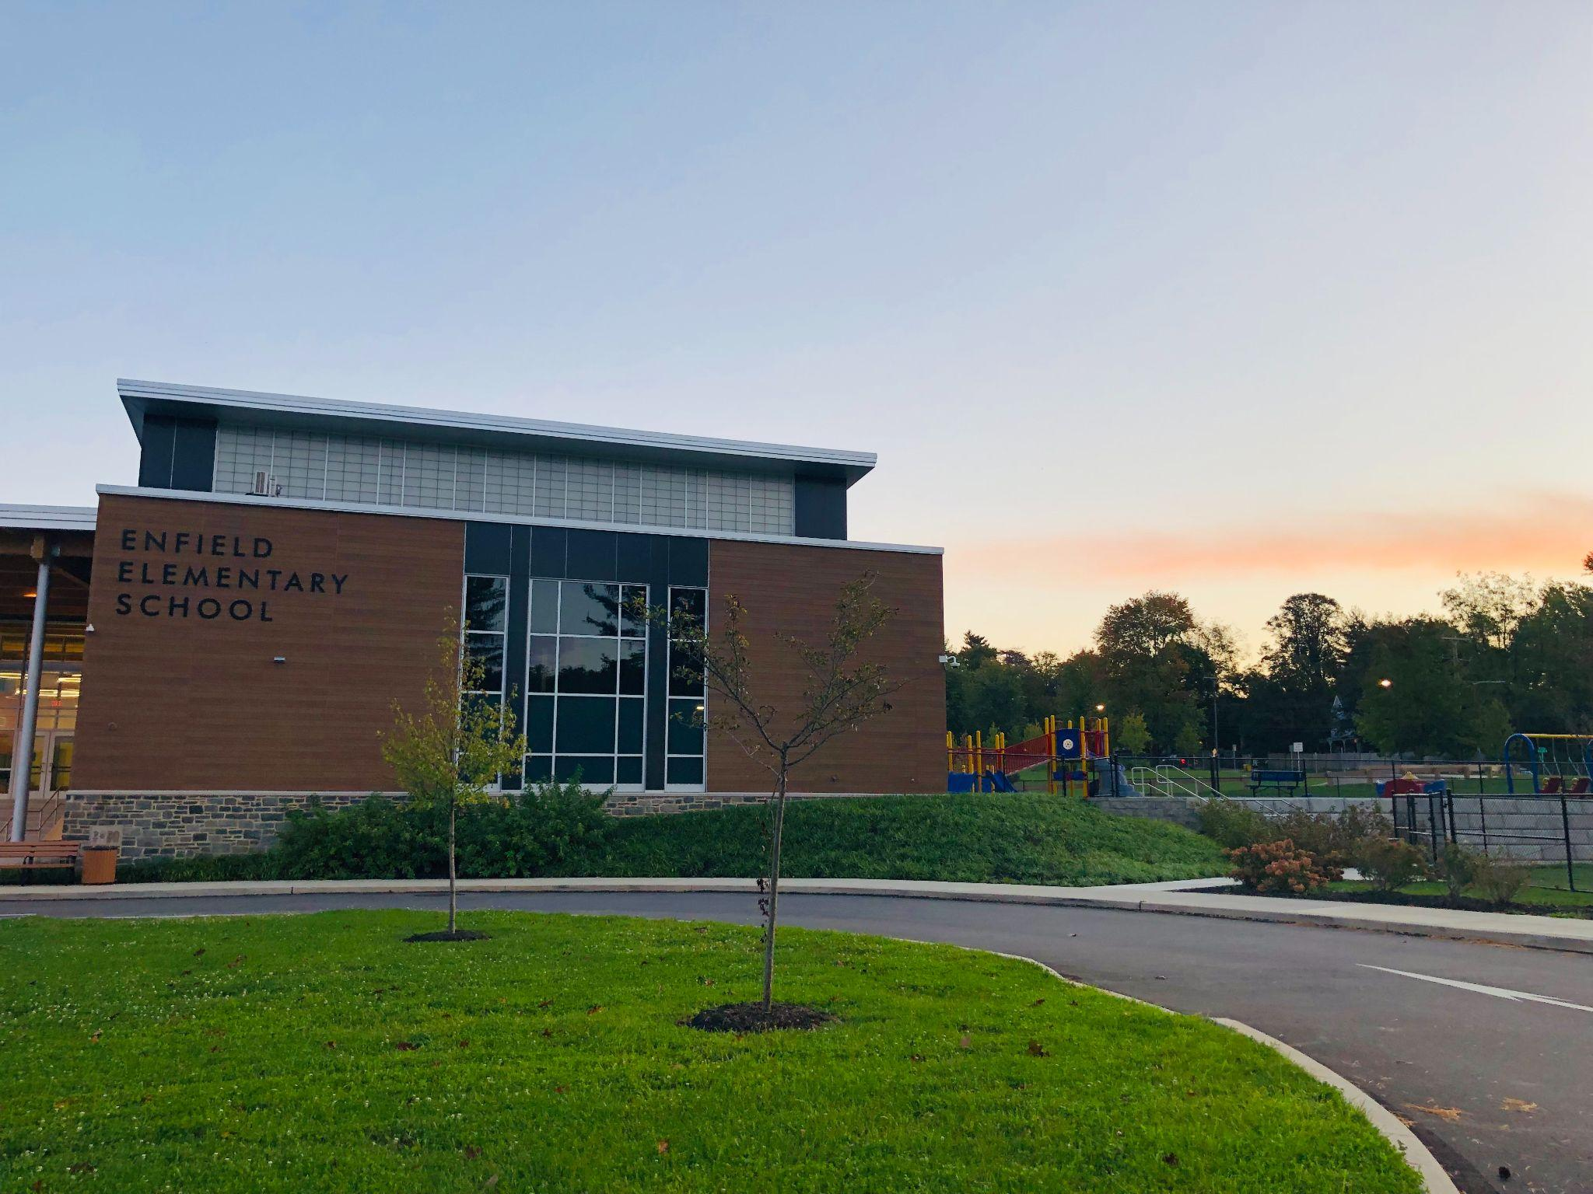
SUBJECT ONE
SUBJECT TWO
SUBJECT THREE
SUBJECT FOUR
Kindergarten Orientation Night
Notes:
Meg

Slide 2
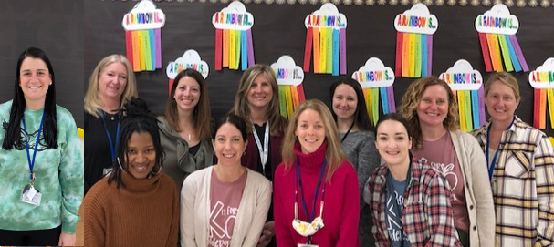
Meet our Kindergarten Team!
Notes:
Meg

Slide 3
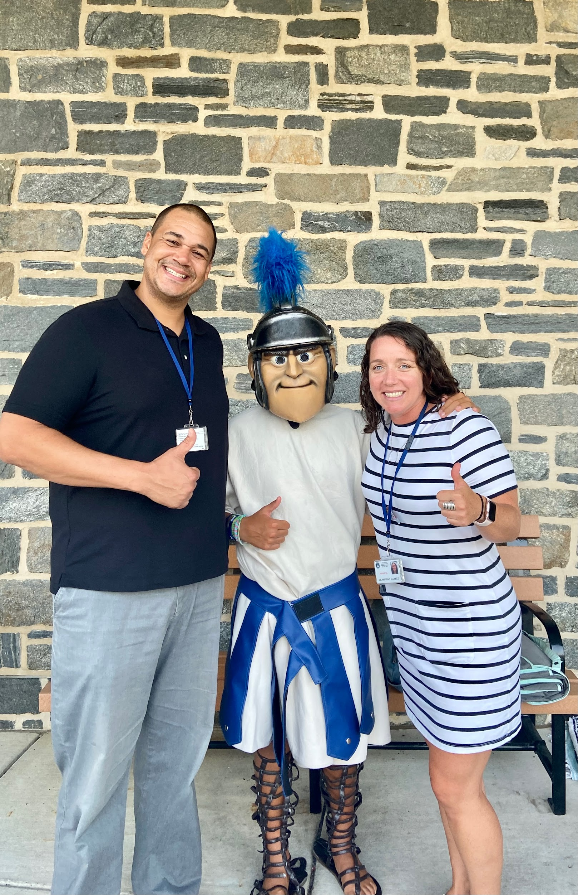
Dr. Meghan Markle,
Principal
Mr. Curtis Fleming, Assistant Principal
Notes:
Intro ourselves

Slide 4
Learning and Growing
Creativity
Collaboration
Accessibility
Technology Integration
Hands On Exploration
Student Choice
Notes:
Meg

Slide 5
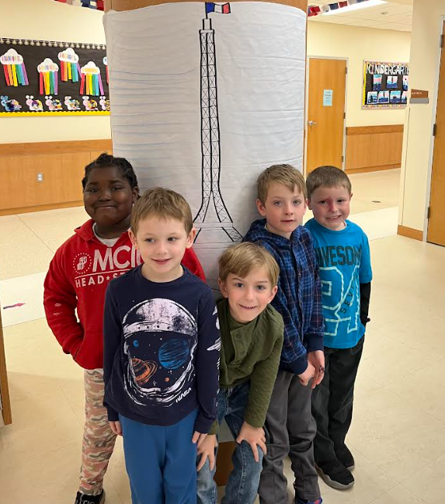
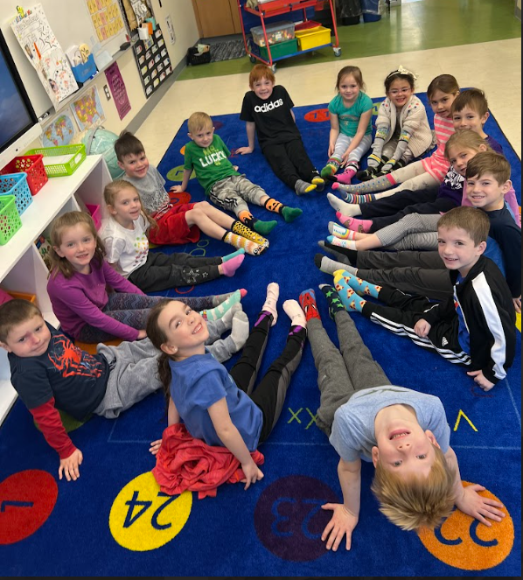
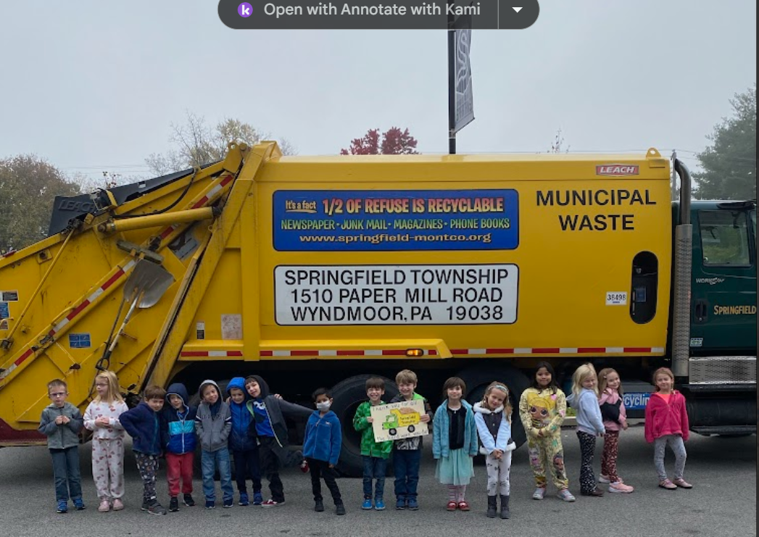
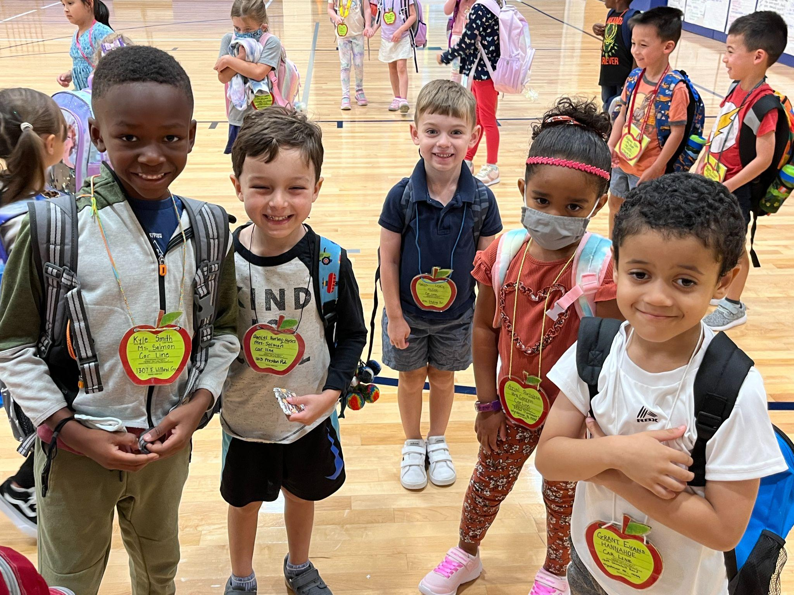
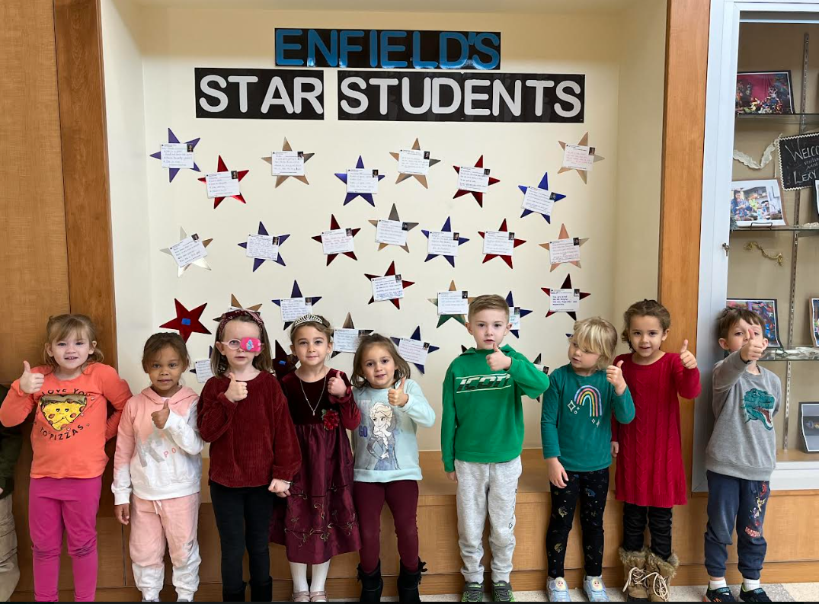
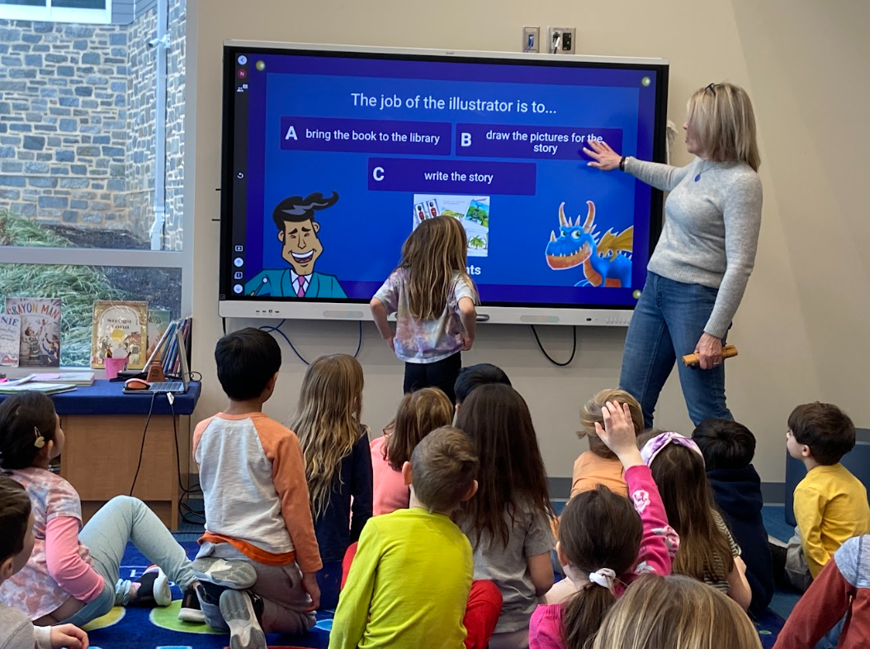
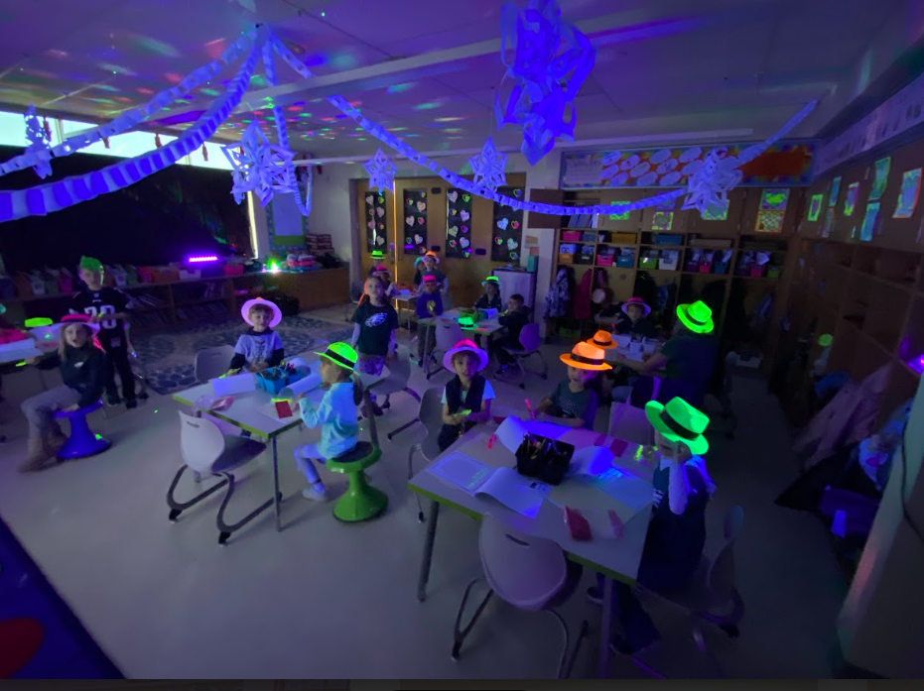
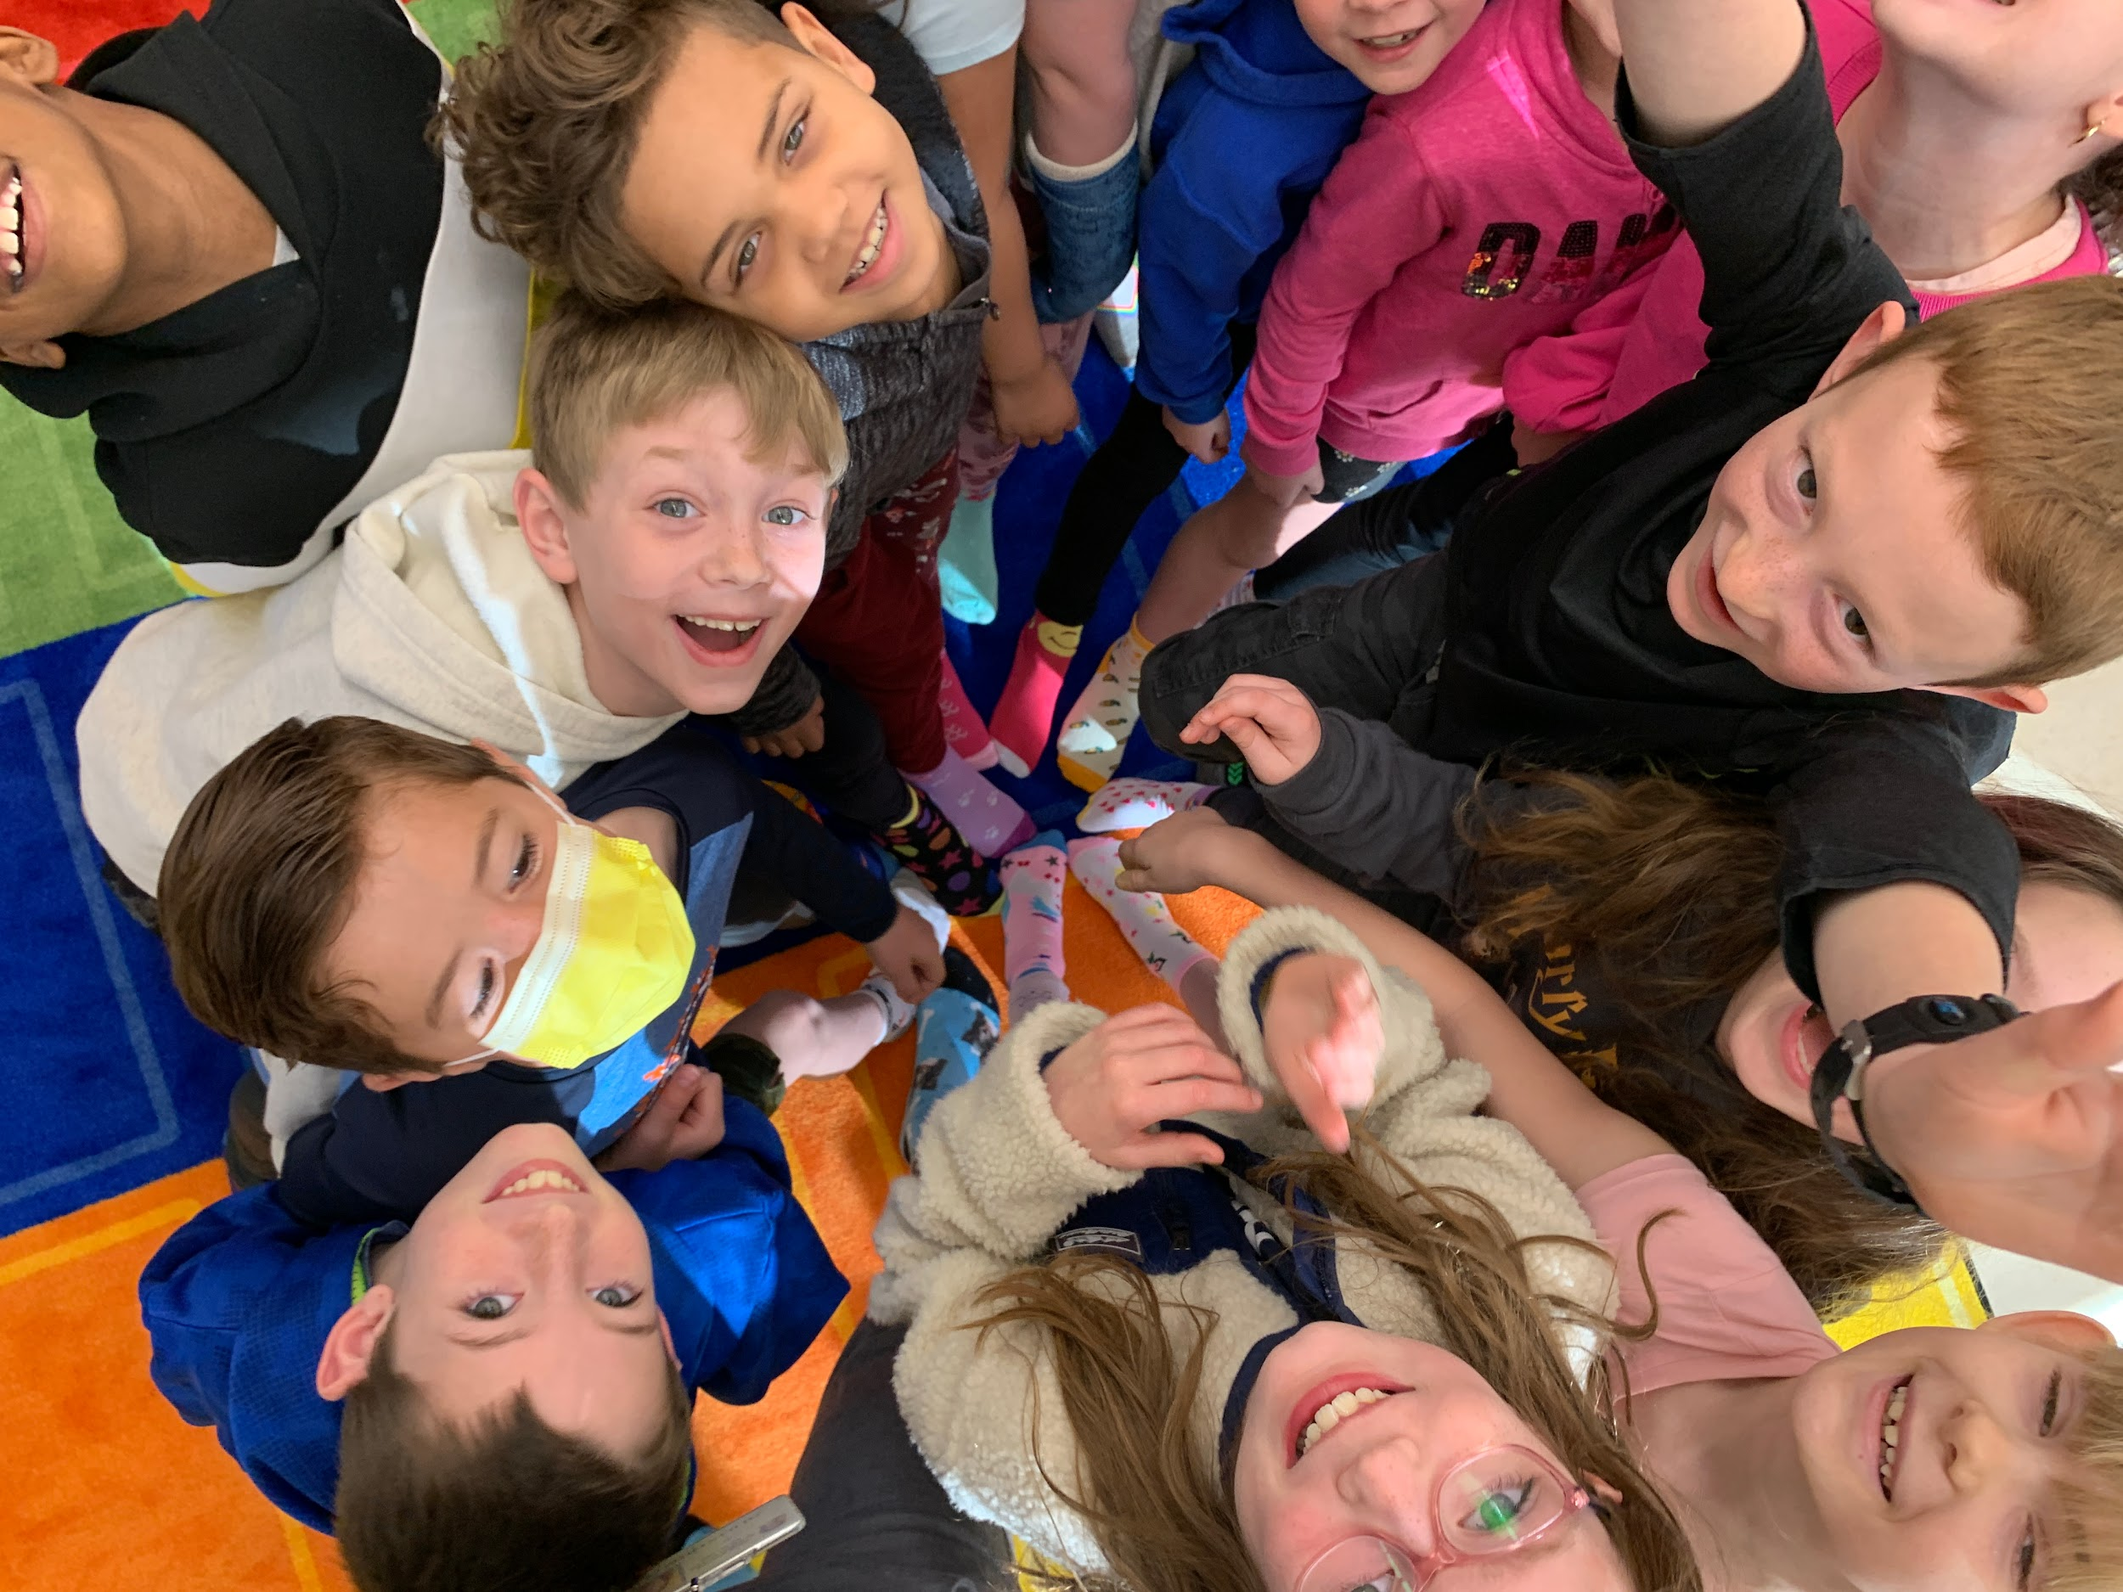
Notes:
Curtis (events)

Slide 6
Overview
Daily Schedule
Academics
Cafeteria Procedures
School Communication
School Procedures
Staff Support
Notes:
Curtis

Slide 7
Daily Schedule:
Unpack/Morning Meeting- 30 minutes
Social Emotional Learning
Responsive Classroom
Social Emotional Curriculum
English/Language Arts (ELA)- 120 minutes
Math- 75 minutes
Science/Social Studies- 40 minutes
Specials- 40 minutes
Art, Music, Physical Education, Library, Technology
5 Day Rotation
Notes:
Curtis

Slide 8
Academics
Operate on Trimester Schedule
Reports Cards Issued- 3 times a year
(Nov, March, June)
Follow PA Core Standards
Curriculum Resources:
Second Step
Fundations
Journeys
Savvas Math (enVision)
Foss Science
Notes:
Meg

Slide 9
Multi -Tiered System of Support (MTSS) Process:
Students received tiered support based on need
academics, social skills, behavior, mental health or other concerns
Team: Principal, Asst. Principal, School Psychologist, Reading Specialists, Emotional Support Teacher, Social Workers, School Counselor, Classroom teacher
Meet Weekly
Team identifies ways to meet the needs of our students and monitor their success
Parents will be notified of any recommendations
Notes:
Meg

Slide 10
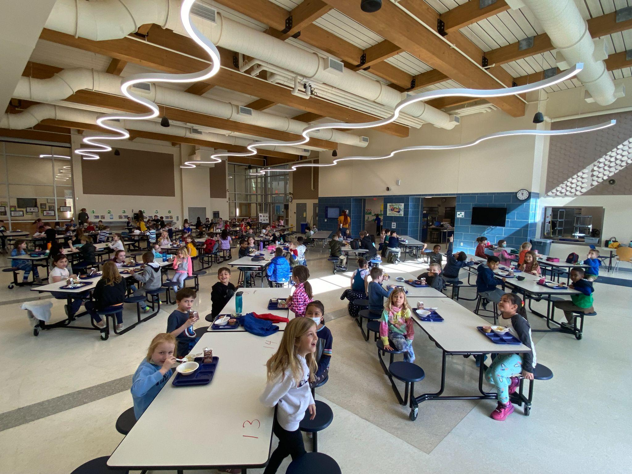
Cafeteria Procedures
Breakfast is served from 8:40-8:55 AM, Daily
Cost= $1.50
Lunch Accounts
-each student has an account
-pay online or bring money to school
Students can choose to pack a lunch or buy a balanced lunch.
Cost= $2.75
Check out site for daily, interactive menu along with information about free and reduced prices
https://www.sdst.org/departments/food-service/index
Notes:
Curtis

Slide 11
Communication- School Messenger System :
Automated system to send out important announcements and upcoming events.
Primary number and emails are in the system- Please keep us up to date with any changes
Used to inform of late openings and early closings
Send Weekly School Newsletters
Send Messages from other District Administrators.
Notes:
Curtis

Slide 12
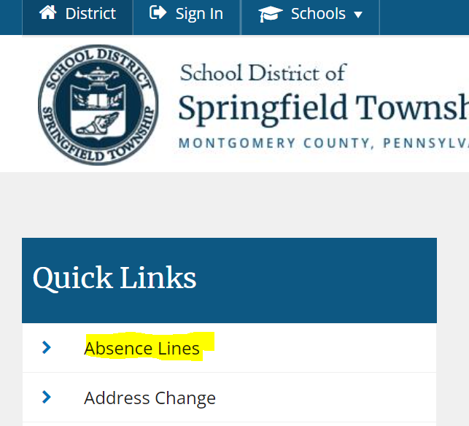
Reporting Absences/Attendance Information:
Check out:
https://www.sdst.org/resources/attendance-procedures
For information about the following:
Reporting absences
Attendance policy
Reasons for excused absences
Resources
Notes:
Meg

Slide 13
Volunteer Policy:
A volunteer shall include but not be limited to the following opportunities:
Assisting with classroom or building special events/celebrations
(excluding public events such as concert or parade)
Chaperoning a single day field trip and/or overnight field trip/competition
Volunteering with any of the district interscholastic athletic teams and musical performance groups
Providing supplemental assistance to a student
Being a Mystery Reader
Volunteering in a classroom
Notes:
meg

Slide 14
Volunteer Policy:
All volunteers have specific requirements that need to be completed PRIOR to participating in any volunteer experience.
* SDST Volunteer Registration and Disclosure Form
* Clearances-
1. PA Criminal History Clearance
2. PA Child Abuse Clearance
3. FBI Fingerprint Criminal Clearance
* TB Test
* Volunteer ID Badge provided by the SDST Human Resource Dept.
Notes:
Meg

Slide 15
Volunteer Policy:
All items must be received BEFORE the volunteer activity.
On the district webpage under “Community,” there is a tab for Volunteer Clearances that walks you through the process. Our social worker can also assist with the steps.
https://www.sdst.org/community/volunteer-clearances
We can not guarantee you will be cleared if you turn in your paperwork the day of the volunteer activity.
Notes:
Meg

Slide 16
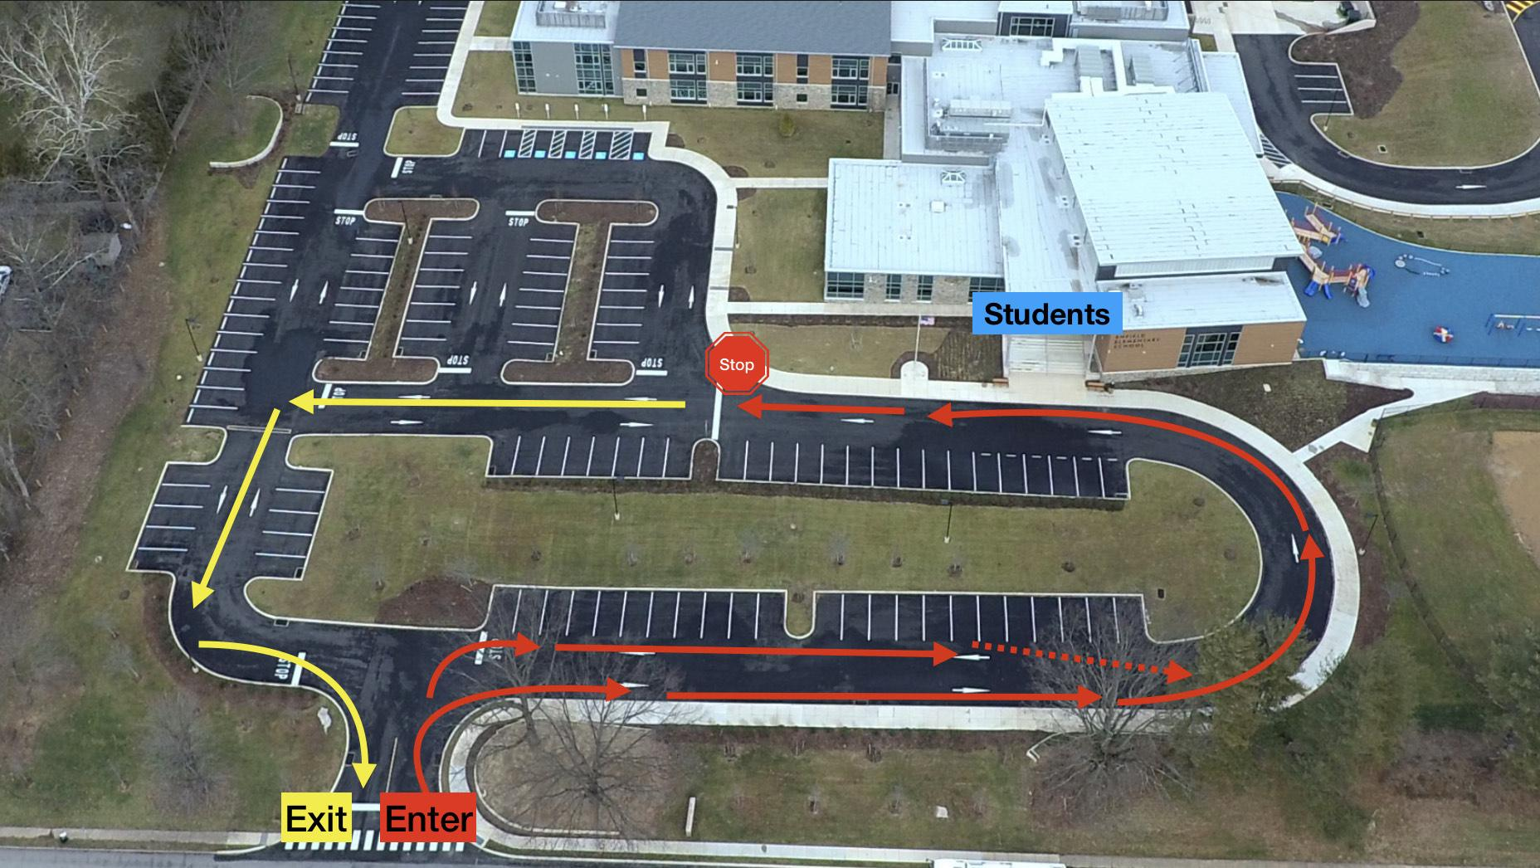
Arrival and Dismissal Procedures:
Doors open at 8:40 am
Car Riders
Dropped off in the front of the school between 8:40-8:55am
Bus Loop- side of school along Paper Mill Road.
Transportation department will share bus information in August
Walkers-
Back of the school near Yeakel Ave & Rorer St
Bus Loop Entrance
Dismissal starts at 3:15pm
Notes:
Curtis

Slide 17
Support from Staff Members:
School Counselor
Social Workers
School Nurse
Administrative
Assistants
Mrs. Mayra Ramos-Cook
Contact:
mayra_ramos-cook@sdst.org
Mrs. Joanne Adar
(M-W-F)
Contact:
joanne_adar@sdst.org
Mrs. Angela Hunt
Contact:
Angela_Hunt@sdst.org
Mrs. Judy Jones
Contact:
judith_jones@sdst.org
Ms. Lynn Miller
Contact: lynn_miller@sdst.org
Notes:
Meg
Counselor
full time counselor
consults with staff members and parents regarding student social/emotional well being.
Social Worker
-help link school, home and community in helping student achieve success
-work directly to support mental health intervention and support services

Slide 18
School Nurse Services:
Call your pediatrician and have them review your child's shot record.
If needed, make an appointment now
Ask your doctor and dentist to complete the Physical Exam and Dental Exam forms based on any exam done after July 1, 2021.
Let us know if your child has any allergies or medical conditions we need to address while at school.
Sign onto our SDST health portal
Access student results for growth, vision, and hearing screenings.
See when your child visits the nurse.
You will be notified by mail or phone if your child does not pass a screening.
Please see directions on how to access your child’s health portal @ https://www.sdst.org/departments/health-services/health-portal
Notes:
Meg

Slide 19
Important Dates:
KDG Round Up- April 18th, 19th, 20th
Summer Building Tours- August (day)
KDG EEHSP Picnic- August (evening)

Slide 20
Q&A
Classroom Presentations up next!
Please proceed to the KDG Classrooms
Check your folder for the Room #
Notes:
Meg

